Slide 1
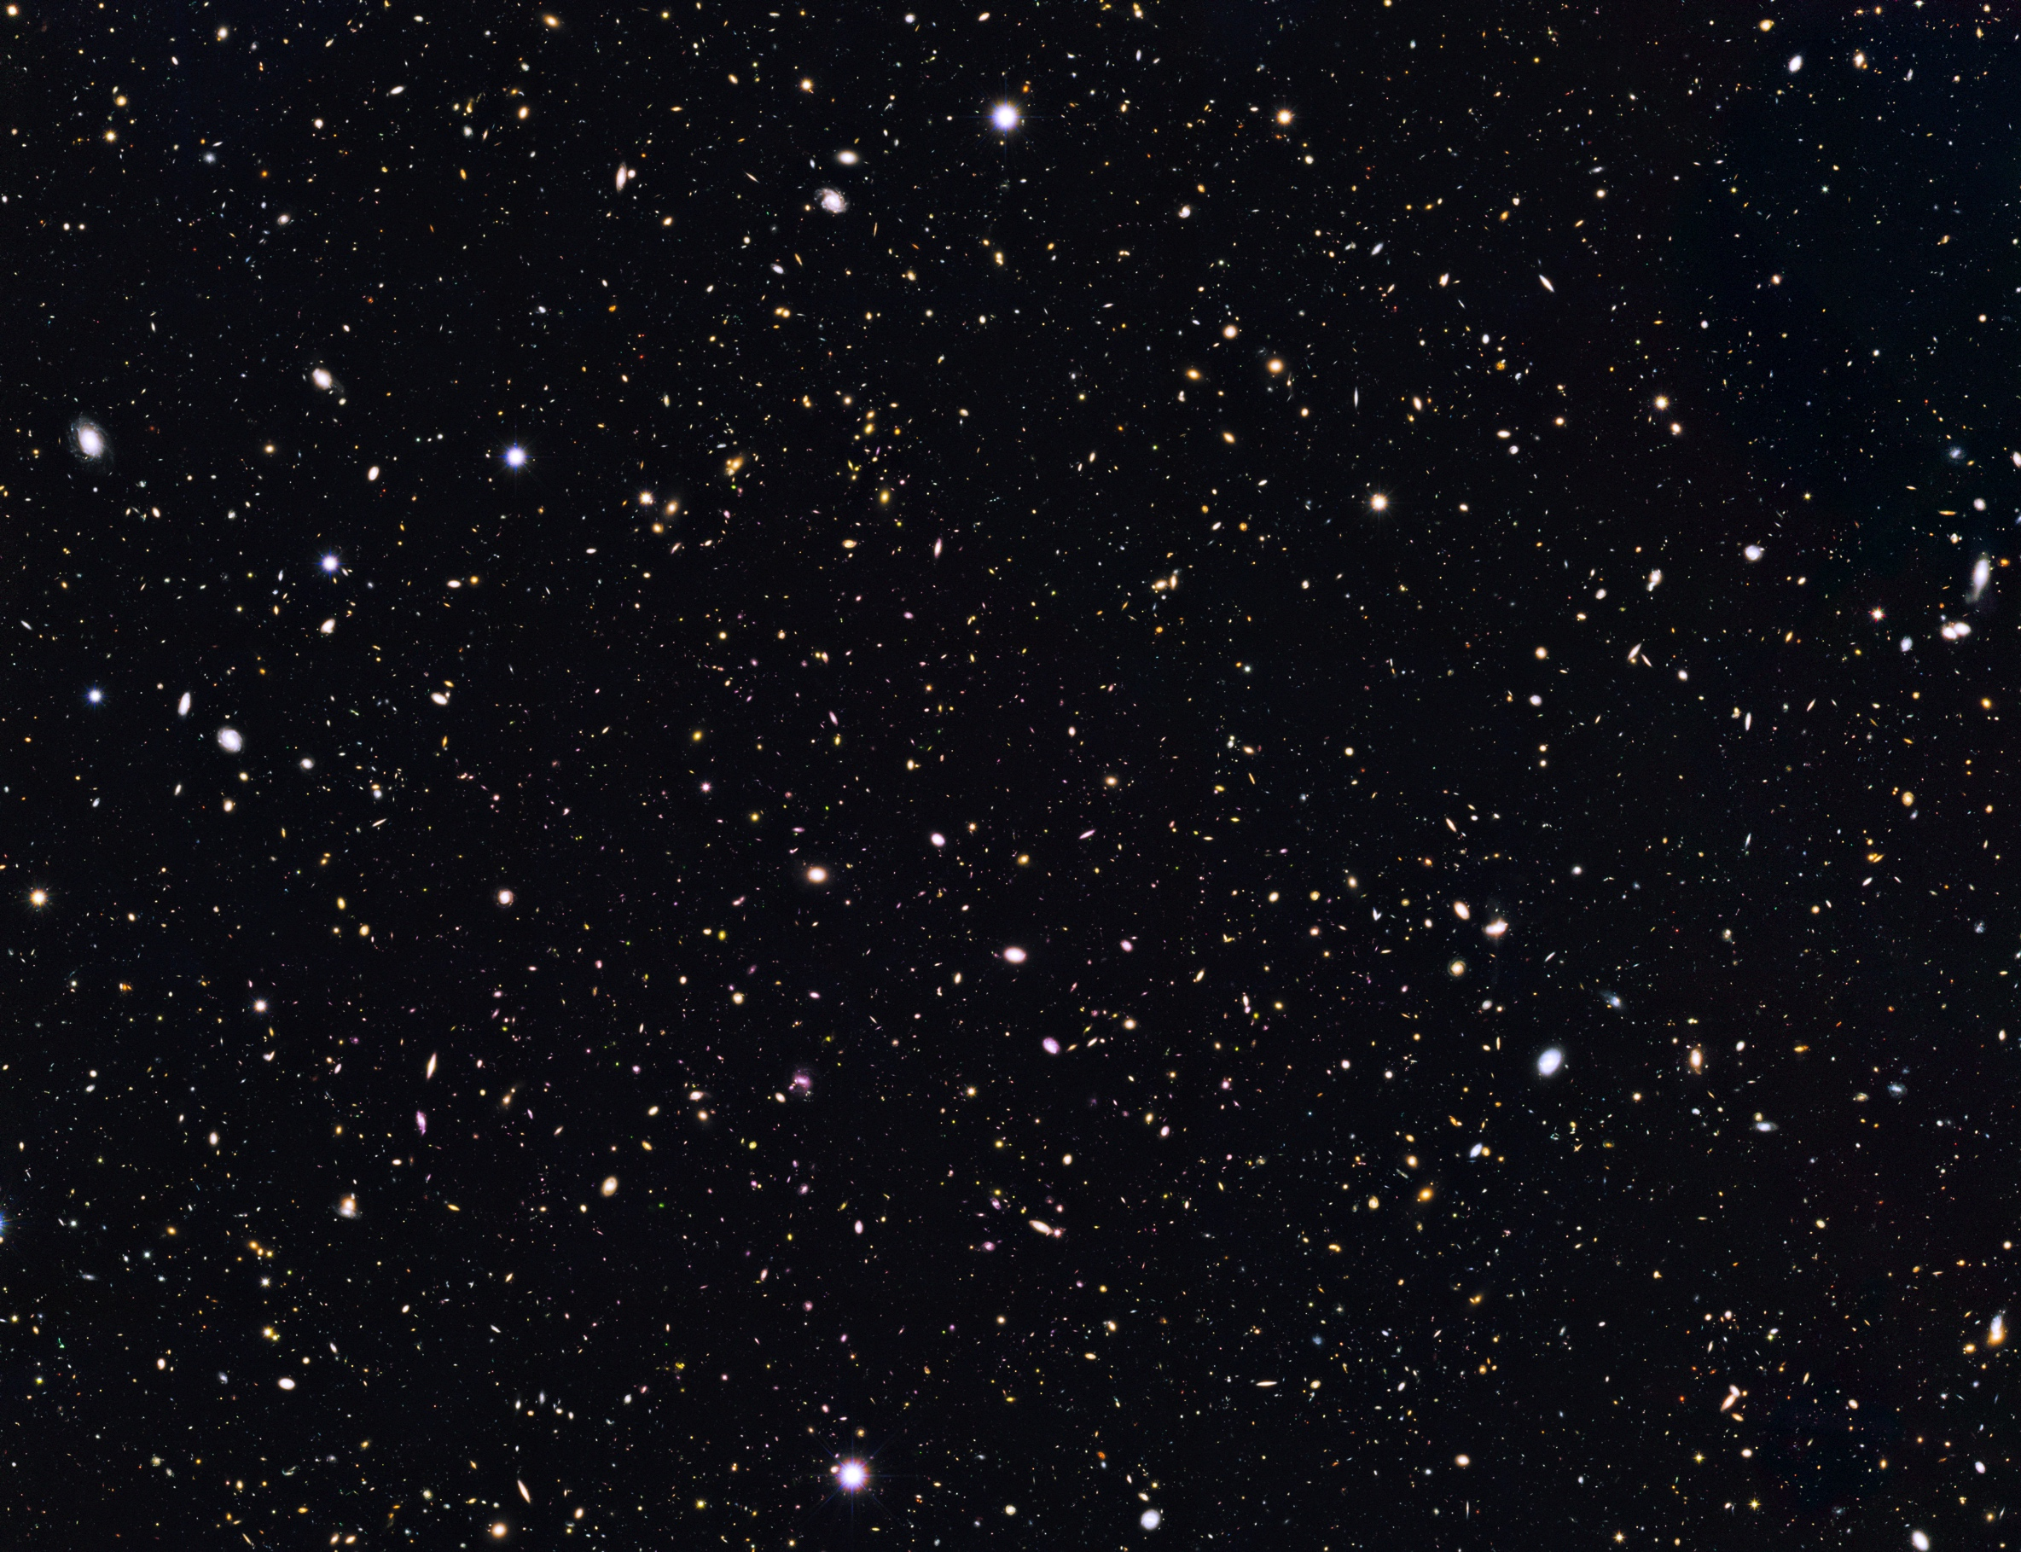


Image credit: ESA/Hubble
HST Observations of Escaping Lyman Continuum Radiation From GOODS-North Galaxies
Cameron White
Dr. Rogier Windhorst
Brent Smith

Slide 2
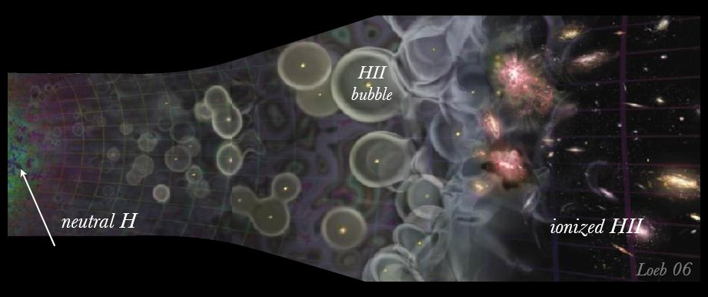
Epoch of Reionization (EoR)
Final major phase transition of Hydrogen in the Universe
Initiated by first objects to emit ionizing radiation (Lyman continuum, λ ≤ 912 Å; LyC hereafter)
Marks the end of the cosmic “Dark Ages”
Complete by ~1 Gyr after Big Bang (z ~ 6)
Image credit: A. Loeb, Scientific American 2006

Slide 3
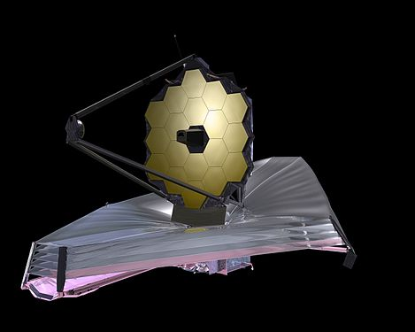
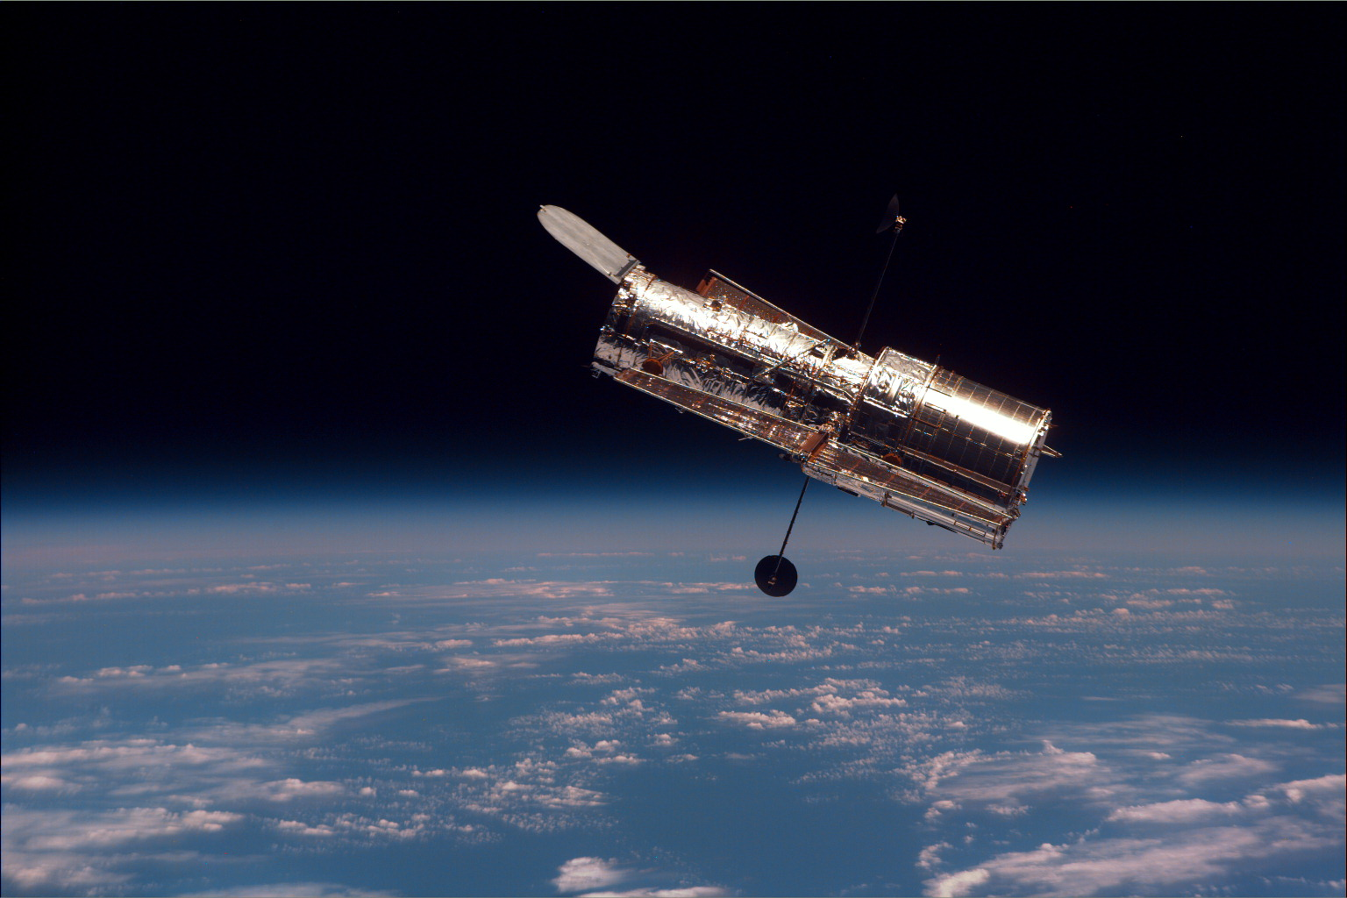
Question
What are the dominant sources of Reionization as a function of cosmic time?

Slide 4
Outline
Candidate selection from GOODS-North redshift catalogs (2.3 < z < 4.5)
HST imaging & spectroscopic sample selection:
  Gather GOODS-N HST WFC3 & ACS imaging data in multiple bands
  Verify published redshifts spectroscopically
  Classify objects according to imaged and spectral features. Diversity is key!

Slide 5
Example 1: SFG
Keck LRIS and HST WFC3 grism spectra alongside HST WFC3 and ACS imaging of z = 2.434 galaxy

Slide 6
Example 2: AGN
Keck DEIMOS and HST WFC3 grism spectra alongside HST WFC3 and ACS imaging of z = 2.592 quasar

Slide 7
Results
Compiled diverse sample of AGN and SFGs with reliable redshifts
Convincing detection of LyC from z = 2.592 QSO in F275W filter
Composite HST image of SFG
Composite HST image of QSO
Image credit: ESA/Hubble
Image credit: ESA/Hubble

Slide 8
Future Work
Stack AGN and SFG imaging to measure total observed LyC flux
Fit spectral energy distributions and utilize IGM transmission models to determine total produced LyC
Plot LyC escape fraction as a function of redshift
JWST follow-up observations will yield more details about physical characteristics of these galaxies

Slide 9


Acknowledgements
Collaborators:
  Rogier Windhorst, Brent Smith, Rolf Jansen, Seth Cohen, Naveen Reddy

